Slide 1
GEOGRAPHICAL INFORMATION SYSTEM
LECT #3
GIS DATA QUALITY

Slide 2
GIS Data Quality and Error Analysis
Data quality is a pillar in any GIS implimentation and application.
Data are indispensable to allow the user obtaining meaningful results.

Slide 3
Component of GIS:
There are four (4) components;
Hardware
Software
data
People (live ware)
Any problem in any of this component, will lead the distortion of the quality in data.
Assume there is a malfunction in a hardware or software component. Or
A problem arise in collecting the data it self e.g. the source of data was not relevant
The skills of people involves in collecting the data was not adequate.
. Any of these may destroy the quality of datasets and hence the quality of the results

Slide 4
Sources of errors in Spatial Data
1. FIELD DATA [ LIVE WARE ]
Human factor is most important in data collection methods to trust on perception
Some observers are inherently more perceptive or industrious than others
Very large differences in the appearance of a map can result from differences in surveyor or from mapping methods.
2. LABORATORY ERRORS
Although determinations carried within a single laboratory using the same procedure may be reproducible, the same cannot be said of analyses performed in different laboratories

Slide 5
3. ACCURACY OF CONTENT
The accuracy of content is the problem of whether the attributes attached to points, lines and areas of the geographic database are correct or free from bias.
E.g. qualitative accuracy: an area on a land use map might be wrongly coded as ‘wheat’ instead of ‘potatoes’
4. MEASUREMENT ERRORS
Poor data can result from unreliable, inaccurate or biased observers or apparatus

Slide 6
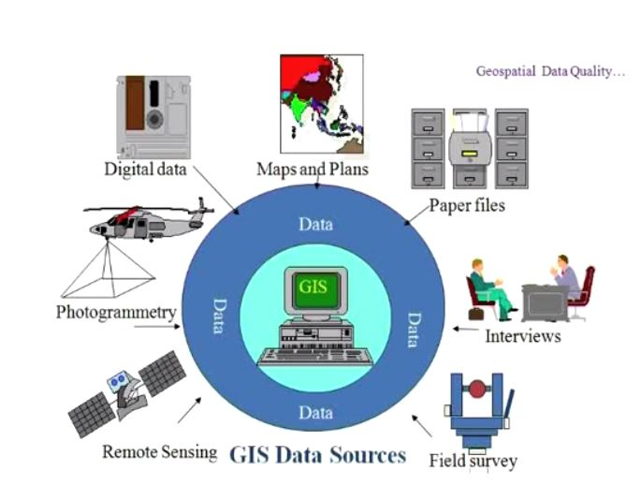

Slide 7
Concern for geospatial data quality
Increased data production by the private sector.
Increased use of GIS as decision-support tool.
Increase reliance on secondary data.
Integration of data from diverse sources/scales
These trends have contributed to a reappraisal of the responsibility of data procedures and consumers for data quality.
MOST FAILED GIS PROJECTS ARE DUE TO POOR PLANNING AND POOR DATA QUALITY

Slide 8
Geospatial Data Quality
A measure of how well the Geospatial Data represents the target domain.
Quality can simply be defined as the fitness for use for a specific data set.
Data that is appropriate for use with one application may not be fit for use with another. It is fully dependent on the scale, accuracy, and extent of the data set, as well as the quality of other data sets to be used.

Slide 9
Spatial data quality
Spatial data quality: The state of accuracy, precision, completeness, consistency and timeliness of the data that makes them appropriate for a particular use

Slide 10
Because of cost constraints it is often more appropriate to manage error than attempt to eliminate it!
There is a trade-off between reducing the level of error in a database and the cost to create and maintain the database.
The validity of any decisions based on a GIS product is directly related to the quality and reliability rating of the product.

Slide 11
Data Quality: How good is your data?
Scale:
Ratio of distance on a map to the equivalent distance on the earth’s surface.
Primarily an output issue, at what scale do I wish to display?
Precision :
Indicate how closely several position fall in relation to each other.
Accuracy:
Is a measure of the closeness of one or more positions to a position that is known and defined in terms of an absolute reference system.
Documentation or Metadata:
Data about data: Recording all of the above

Slide 12
Accuracy should be in:
Position Accuracy
Attribute Accuracy
Logical Consistency

Slide 13
Positional accuracy
How closely the coordinate descriptions of features represented in the data compare to their true location
Often measured in terms of RMSE

Slide 14
Attribute accuracy
How closely the attribute values of features represented in the data compare to their true values
Measured using an error matrix

Slide 15
Logical Consistency: This component is concerned with determining the faithfulness of the data structure for a data set. This typically involves spatial data inconsistencies such as incorrect line intersections, duplicate lines or boundaries, or gap in lines. These are referred to as spatial or topological errors

Slide 16

Kappa
Kappa statistic
Estimated as
Reflects the difference between actual agreement and the agreement expected by chance.
It can take values from 0 to 1. If kappa coefficient equal to 0, there is no agreement between the actual value and observed value.

Slide 17
Factors affecting the reliability of spatial data
Age of data
Arial coverage
Map scale and resolution
Density of Observation
Data format, data exchange, & interoperability
Accessibility

Slide 18
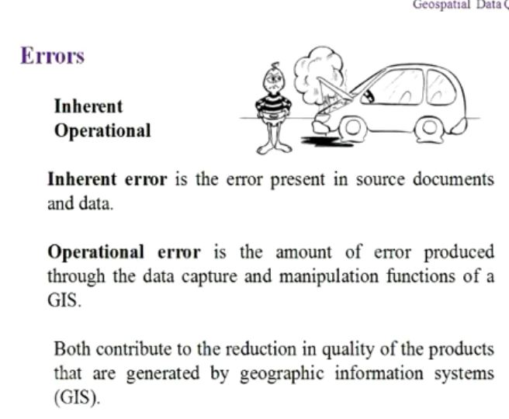
Categories of Error
Inherent error:
Is the error presented in source documents and data
Operational:
Is the amount of error produced through the data capture and manipulation functions of GIS.
Both contribute to the reduction in quality of the products that are generated by geographic information system (GIS)

Slide 19
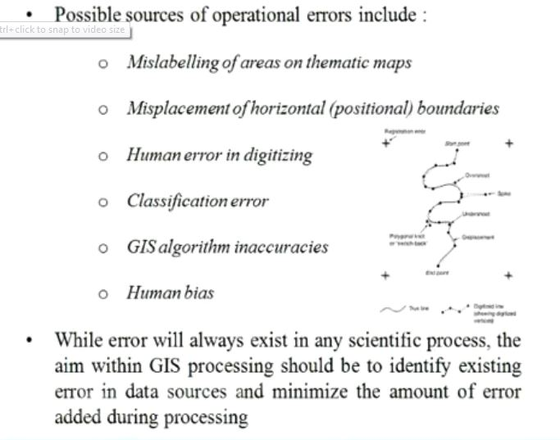

Slide 20
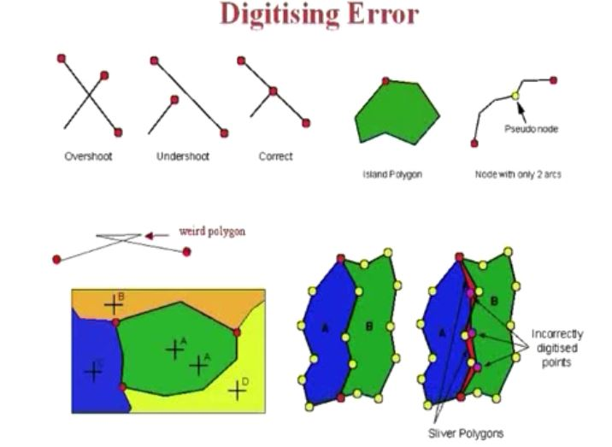
Digitizing error

Slide 21
What is metadata?
In GIS, Metadata is data about data. It consists of information that describe spatial data and is used to provide documentation for data products. Metadata is the who, what, when, where, why, and how about every facet of the spatial data.
According to the Federal Geographic Data Committee (FGDC), metadata is data about the content, quality, condition and other characteristics of data.

Slide 22
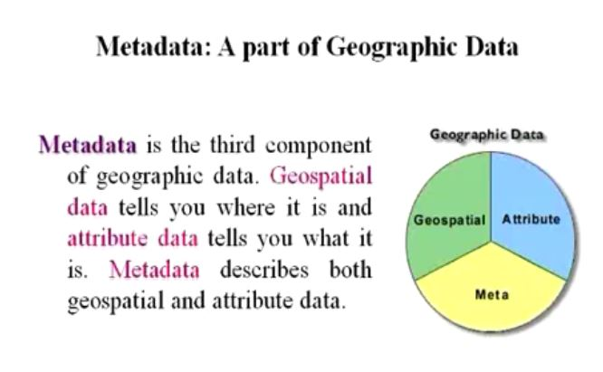
Metadata: A part of Geographic Data
Metadata: is the third component of geographic data. Geospatial data tells you where it is and attribute data tells you what it is. Metadata describes both geospatial and attribute data.

Slide 23
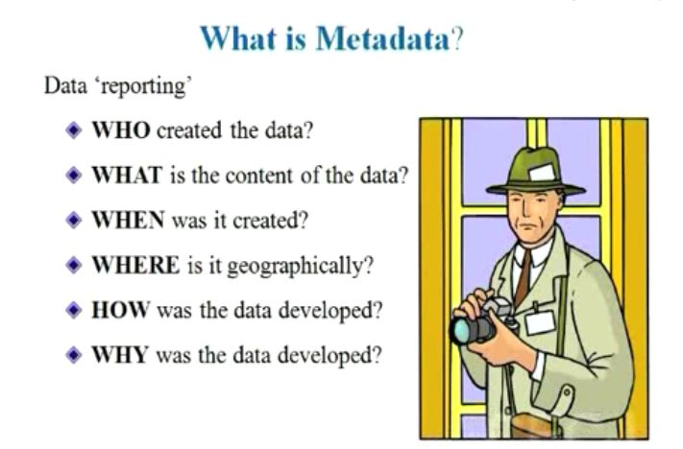
What is Metadata?
Data ‘reporting’
WHO created the data
WHAT is the contents of the data.
WHEN was it created.
WHERE is it geographically.
HOW was the data developed.
WHY was the data developed

Slide 24
Metadata should include data about:
Date of data collected.
Bounding coordinates
Processing steps
Software used
RMSE, ETC
From where original data came.
Who did processing.
Projection
Coordinate system
Datum
Units
Spatial scale
Attribute definitions
Who to contact for more information.

Slide 25
Metadata Standards
e.g. ISO 19139 Metadata Implementation Specification, ISO 19115 Geographic Information, FGDC CSDGM Metadata, the North American Profile of ISO 19115,INSPIRE Metadata Directive and ANZLIC Metadata Guidelines

Slide 26
Thanks
Question ?

